Slide 1
.NET MAUI Performance Optimizations: NativeAOT and Trimming
Jonathan Peppers

Slide 2
What is Trimming? NativeAOT?
Zero Trimmer Warnings in .NET MAUI
Settings: NuGet package authors vs Apps
Agenda
Trim-safe .NET libraries, System.Reflection usage
Trim-safe XAML & data-binding
Results: Graphs!

Slide 3
01
What even is Trimming? NativeAOT?

Slide 4
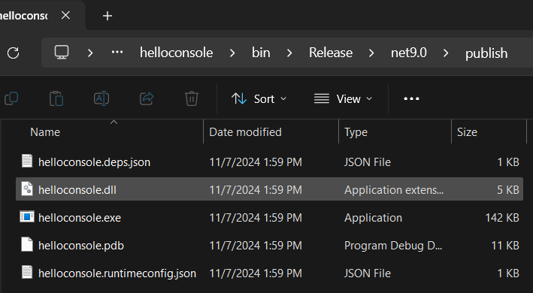
dotnet new console
dotnet publish
Note this is Release mode by default now.
We get a .dll and an .exe, nice!
This will run on our desktop, but it will not run on machines without .NET installed.

Slide 5
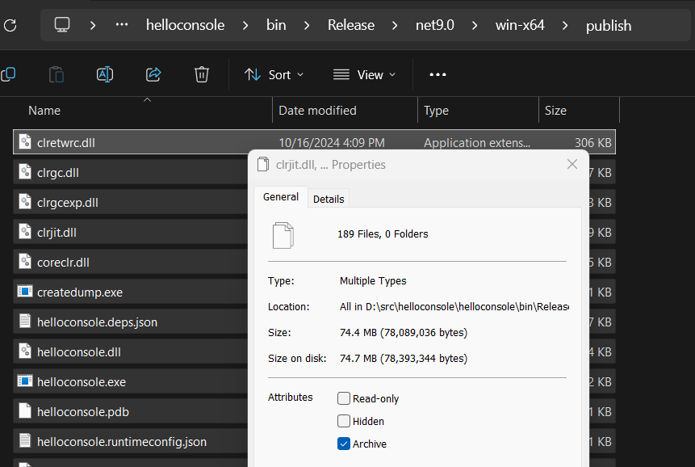
Self-contained app?
dotnet publish --self-contained
Note the files are now in win-x64/publish, if you built from a Windows x64 machine.
That’s a lot of files! Disk space!
Files are OS and architecture specific

Slide 6
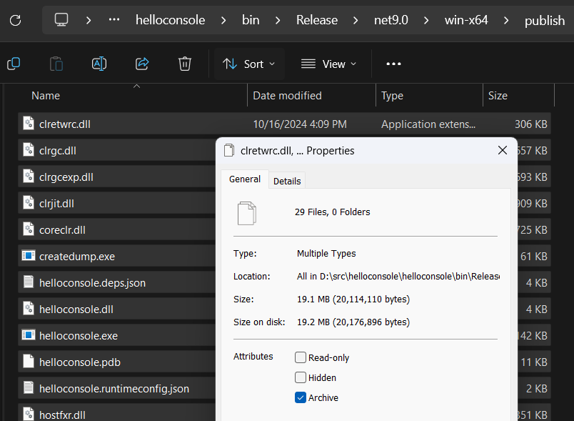
Trimming to the rescue!
dotnet publish -p:PublishTrimmed=true
Runs all .NET assemblies through the .NET trimmer, ILLink
Many less files.
~74MB ➡️ ~19MB
Still OS and architecture specific

Slide 7
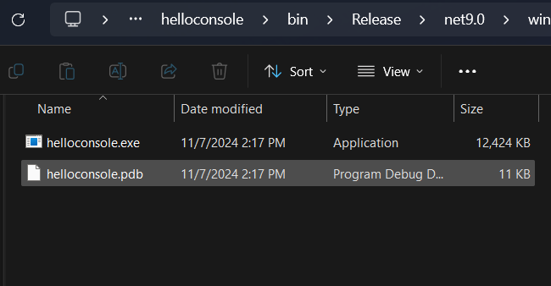
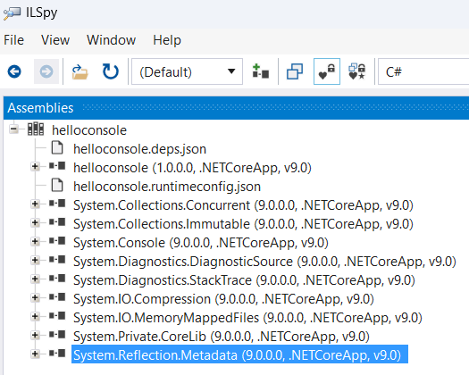
Single file mode
dotnet publish -p:PublishSingleFile=true
Runs all .NET assemblies through the .NET trimmer, ILLink
Compresses everything into one file!
~19MB ➡️ ~12MB
Still OS and architecture specific

Slide 8
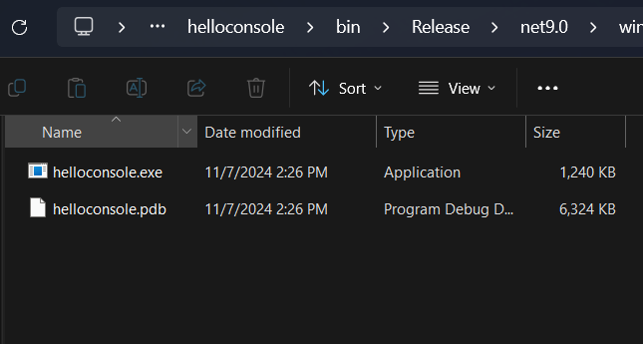
NativeAOT, a new runtime
dotnet publish -p:PublishAot=true
Runs all .NET assemblies through the trimmer and NativeAOT compiler, ILC
Compiles all managed code to native code
No longer runs on CoreCLR runtime, runs on NativeAOT runtime
~12MB ➡️ ~1MB ?!?
Still OS and architecture specific
There are still settings to make it even smaller:
InvariantGlobalization=true
UseSystemResourceKey=true
NullabilityInfoContextSupport=false
IlcDisableReflection=true
StackTraceSupport=true
OptimizationPreference=Size

Slide 9
What settings for app stores? (mobile)
Release builds of .NET MAUI projects are self-contained and trimmed. TrimMode=partial is the “safe” trimming mode that does not trim your code or NuGet references.
Windows, iOS, macOS: in .NET 9, NativeAOT is no longer experimental.
NativeAOT not yet supported on Android.

Slide 10
What about Mono?
iOS, Android, MacCatalyst all use the Mono runtime by default.
Release builds use Mono’s AOT by default.
Mono’s AOT results in faster startup, at the cost of larger app sizes.
NativeAOT, however, can result in smaller app sizes.
NativeAOT, requires a bit of work to setup: trimmer warnings.

Slide 11
02
Zero Trimmer Warnings in .NET MAUI

Slide 12
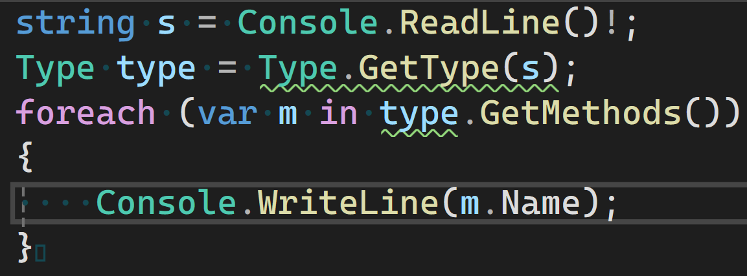
Code Example

Slide 13
Trimmer Warnings, back in .NET 8
Oh dear!
~15 warnings from Java.Interop.dll
~7 warnings from Mono.Android.dll (Android API)
~97 warnings from Microsoft.Maui.*.dll
iOS, MacCatalyst, etc. also had their own warnings
Goal: solved in .NET 9

Slide 14
03
Settings: NuGet packages vs applications

Slide 15
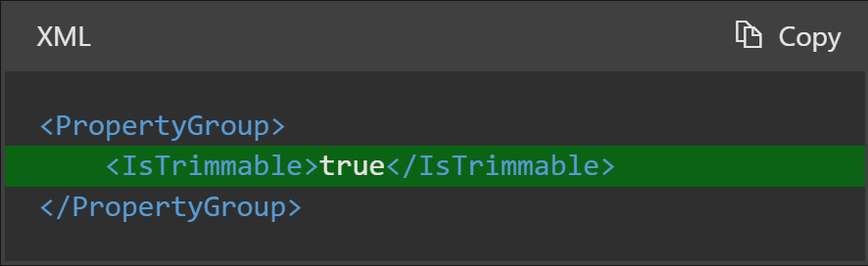
NuGets: mark project “Trimmable”
https://learn.microsoft.com/dotnet/core/deploying/trimming/prepare-libraries-for-trimming

Slide 16
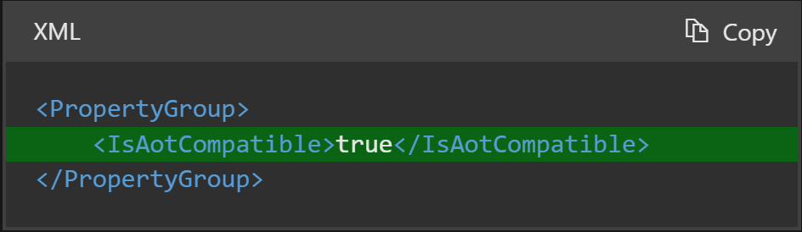
NuGets: mark project “AOT Compatible”
https://learn.microsoft.com/dotnet/core/deploying/trimming/prepare-libraries-for-trimming

Slide 17
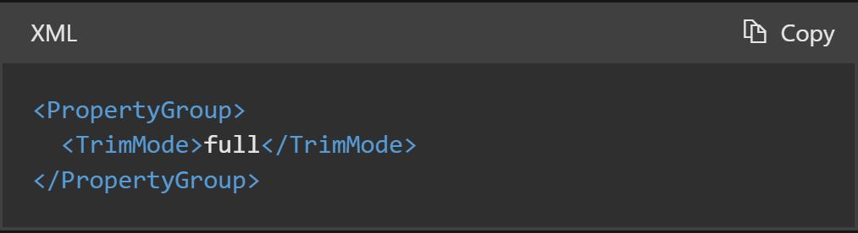
Applications: opt into Full Trimming
https://learn.microsoft.com/dotnet/maui/deployment/trimming

Slide 18
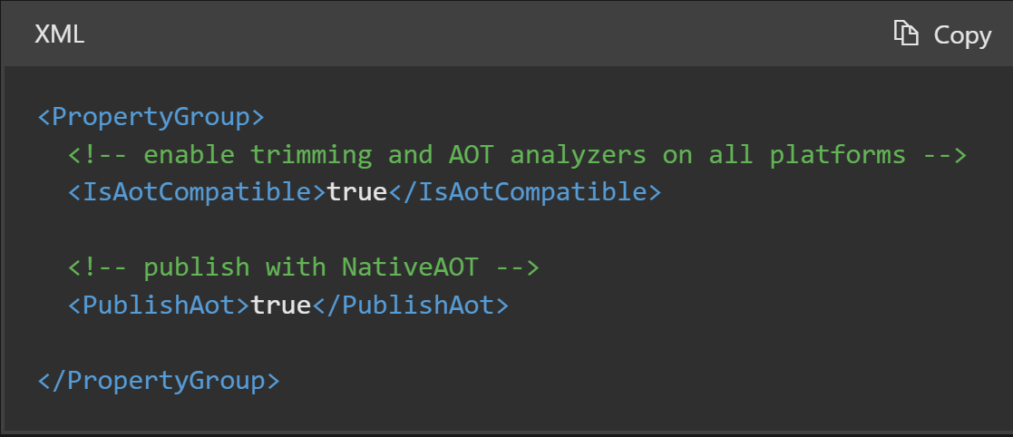
iOS & macOS: opt into NativeAOT
https://learn.microsoft.com/dotnet/maui/deployment/nativeaot

Slide 19
04
Trim-safe .NET libraries &
System.Reflection

Slide 20
Code Example

Slide 21
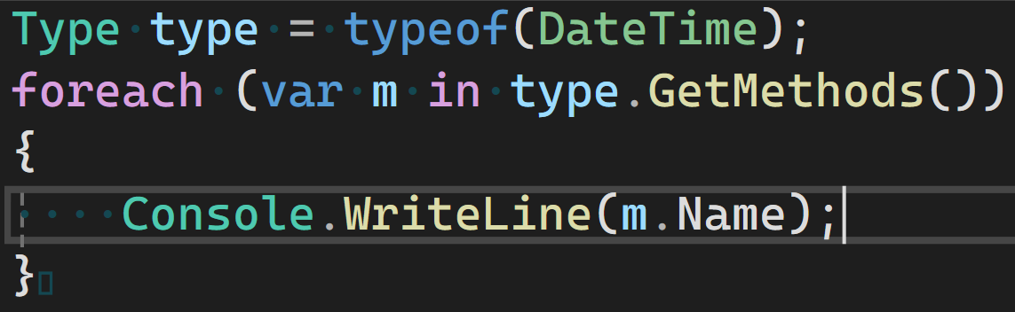
Fixed it!

Slide 22
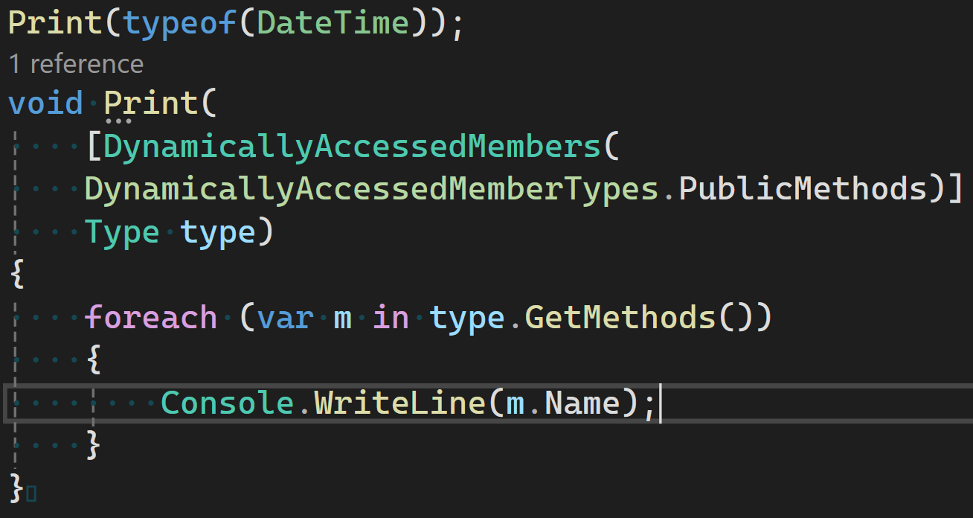
Method & Type Parameter

Slide 23
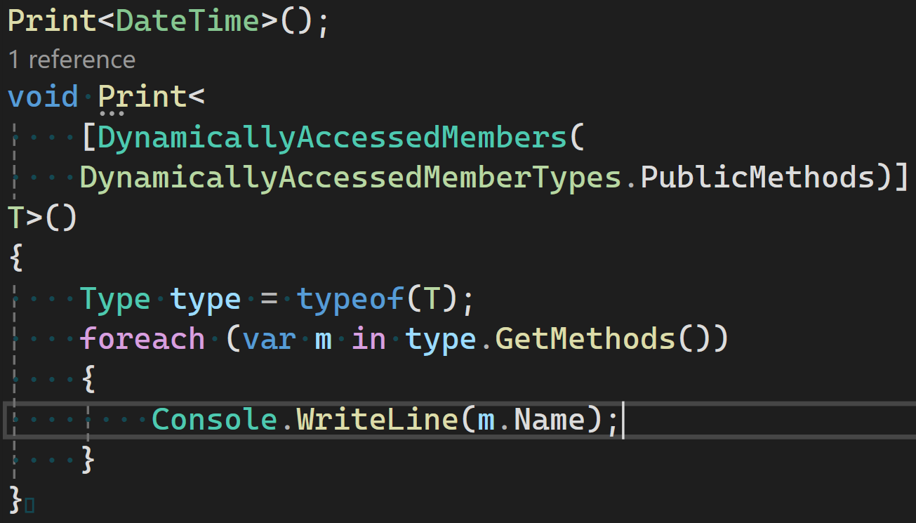
Generics

Slide 24
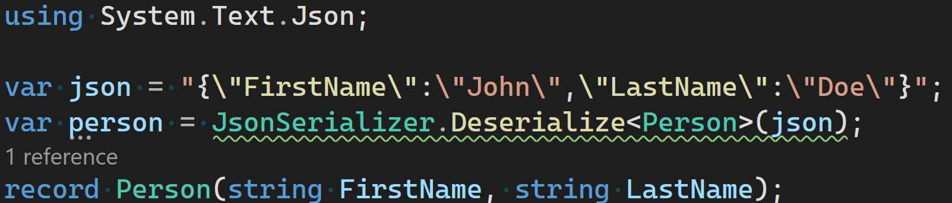
JSON Parsing

Slide 25
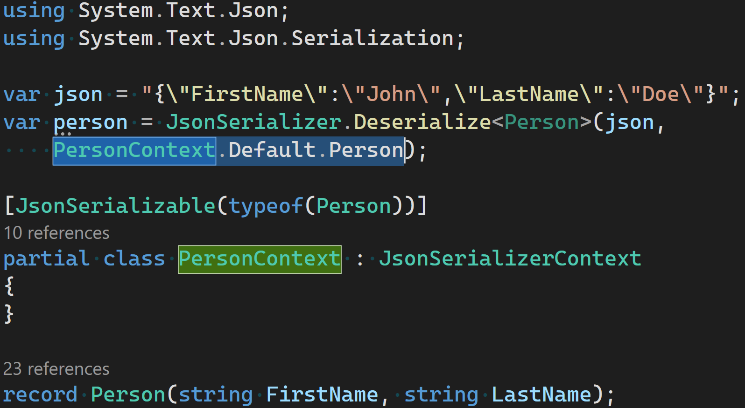

Slide 26
05
Trim-safe XAML and data-binding

Slide 27
XAML Data-Binding

Slide 28
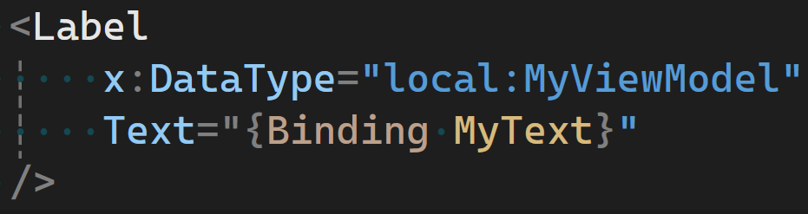
x:DataType

Slide 29
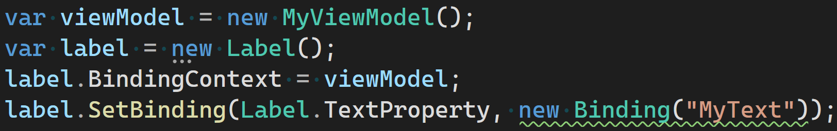
C# Data-Binding

Slide 30
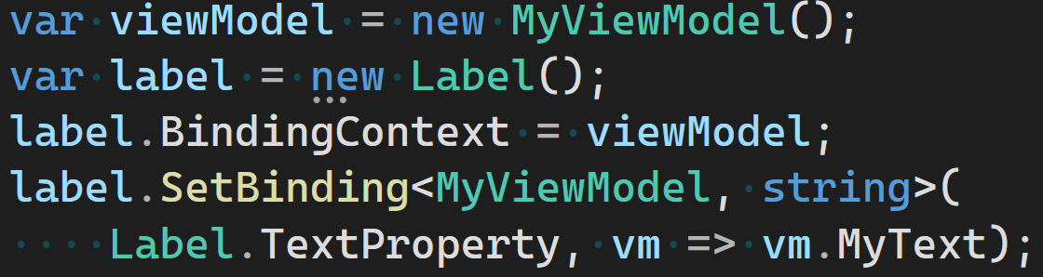
Strongly-Typed Data-Binding

Slide 31
06
Results!

Slide 32
App Size: Android

Slide 33
App Size: iOS and macOS

Slide 34
Startup Time

Slide 35
Resources
https://learn.microsoft.com/dotnet/maui/deployment/trimming
https://learn.microsoft.com/dotnet/maui/deployment/nativeaot
https://learn.microsoft.com/dotnet/core/deploying/trimming/fixing-warnings
https://learn.microsoft.com/dotnet/core/deploying/trimming/prepare-libraries-for-trimming

Slide 36

Get .NET 9
Download .NET 9 aka.ms/get-dotnet-9

Slide 37
Thank you

